Slide 1
Enhancing Production Performance through the Reduction of Machine Downtime at Kraft Heinz Seven Hills, NSW
BUSM7012 Business Project Q3 2023 Prof. Krishnamurthy Ramanathan Presented by Sanket Shinde 20097530

Slide 2
1. Introduction
Reducing downtime in food production plants is crucial for optimizing resource utilization, improving operational efficiency, and enhancing profitability.
Reducing equipment downtime provides additional benefits such as increased efficiency, improved machine availability, higher throughput, and shorter order lead times.

Slide 3
2. Background Information
The company specializes in the manufacturing of prepared foods and miscellaneous food specialties, operating in a competitive market landscape.
The focus of this project is on the Seven Hills production unit of Kraft Heinz Australia, aiming to optimize production performance and minimize downtime occurrences.
By addressing downtime issues, Kraft Heinz Australia can enhance productivity, reduce costs, improve customer satisfaction, and strengthen its market position.
Kraft Heinz Australia is a subsidiary of the multinational food and beverage company Kraft Heinz Company, with a turnover of around A$1.2 billion.

Slide 4
3. Overall Objective of the Study
The overall objective of this project is therefore to identify and address the primary causes of downtime in the six production lines of the wet section of the Kraft Heinz Seven Hills, with a view towards enhancing productivity and competitiveness through on time delivery of quality products to customers.
To help achieve this overall objective, five research questions have been formulated.

Slide 5
3.1 Research Questions
What are the primary causes of downtime in each production line at the wet section of Kraft Heinz Seven Hills?
What impact is current downtime having on the cost of production and planned output?
What patterns or trends can be observed regarding downtime occurrences and their impact on production targets?
What approaches can be adopted to reduce downtime?
Based on the findings of the above four research questions, what recommendations can be provided to ensure that proper maintenance procedures are used to reduce downtime on priority production lines so that production can be enhanced?

Slide 6
4. Situation Analysis: Bottling Process at Kraft Heinz
The production line for bottling sauces, pastes, and chutneys at Kraft Heinz follows a structured workflow, starting with empty bottle transfer onto a conveyor.
The depalletiser stage involves manual or automated transfer of bottles from pallets to the conveyor.
Labelling and printing section adds labels, work orders, and best-before dates to the bottles after depalletizing.
The filler section fills bottles with the intended product, followed by capping at the adjacent capper station.
Safety is ensured with an X-ray detection system for contamination identification.
Cooling, disinfection, carton forming, pallet stacking, and warehousing complete the production process consistently across lines.

Slide 7
4.1 Downtime Report at Kraft Heinz Seven Hills
Kraft Heinz's Engineering department employs a downtime code system consisting of 10 distinct groups for recording downtime issues.
Downtime codes facilitated accurate reporting and understanding of downtime causes
The first five groups focused on scheduled downtime and were not part of the analysis.
The analysis concentrated on the remaining four groups: Equipment Failure, Logistics, Operational, Quality Loss and Planned Changeover and Sanitation which present improvement opportunities.
Operators and engineers used codes to document downtime incidents, enabling detailed analysis of primary causes for each production line.

Slide 8
5. Addressing Research Question 1
What are the primary causes of downtime in each production line at the wet section of Kraft Heinz Seven Hills?

Slide 9
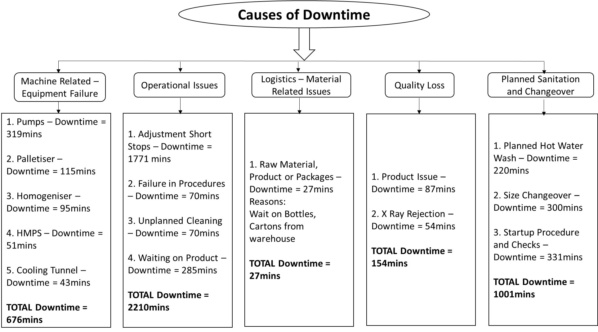
5.1 Catering Line(1st April to 1st May 2023)
Sauce Bottles ranging from 2 litres to 4 litres

Slide 10
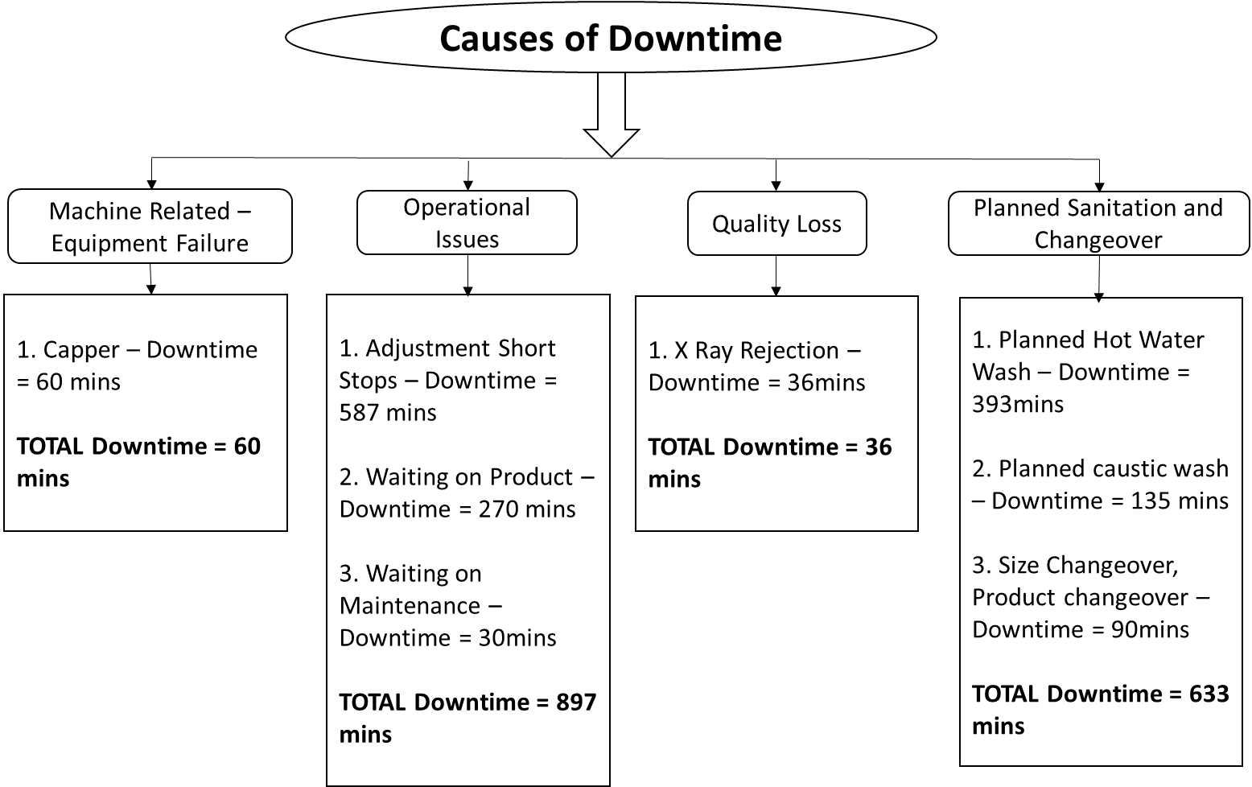
5.2 Hunter Line(1st March to 1st April 2023)
Sauce Bottles ranging from 2 litres to 4 litres

Slide 11
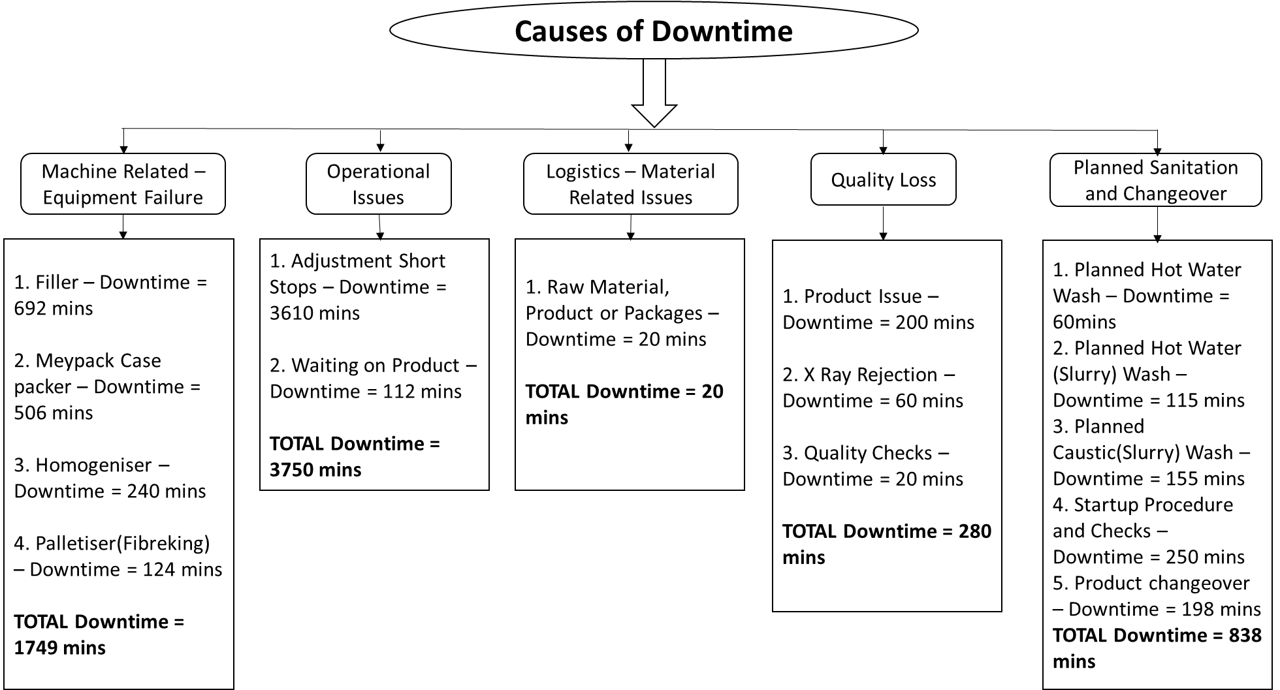
5.3 Main Line(1st April to 1st May 2023)
Sauce Bottles of range 500ml-600ml (plastic/glass)

Slide 12
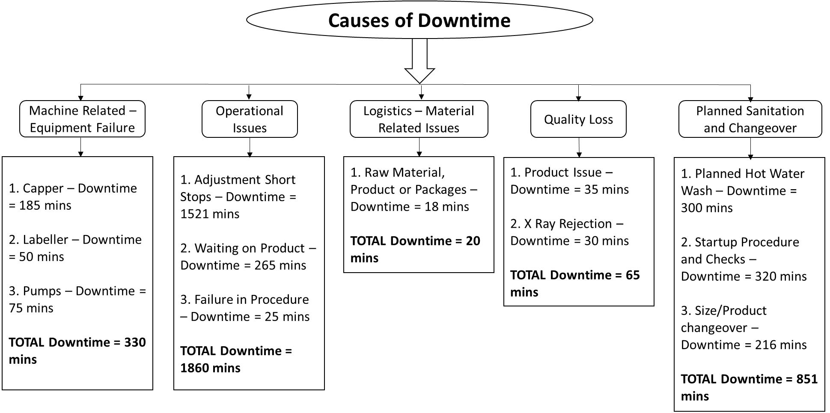
5.4 Table Sauce Line(1st April to 1st May 2023)
Sauce Bottles of range 200ml-400ml (glass)

Slide 13
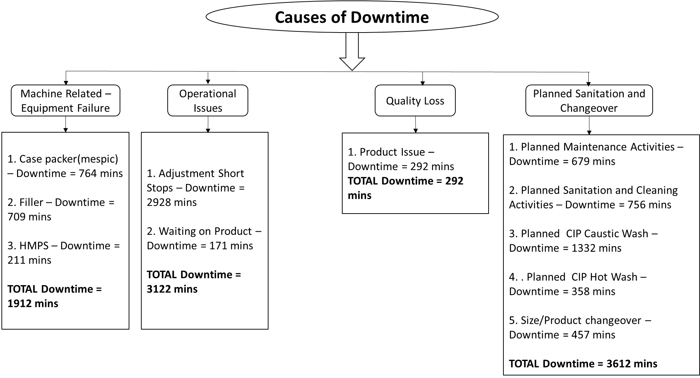
5.5 Liquid Gravy Line(1st April to 1st May 2023)
Pouches of 200gms

Slide 14
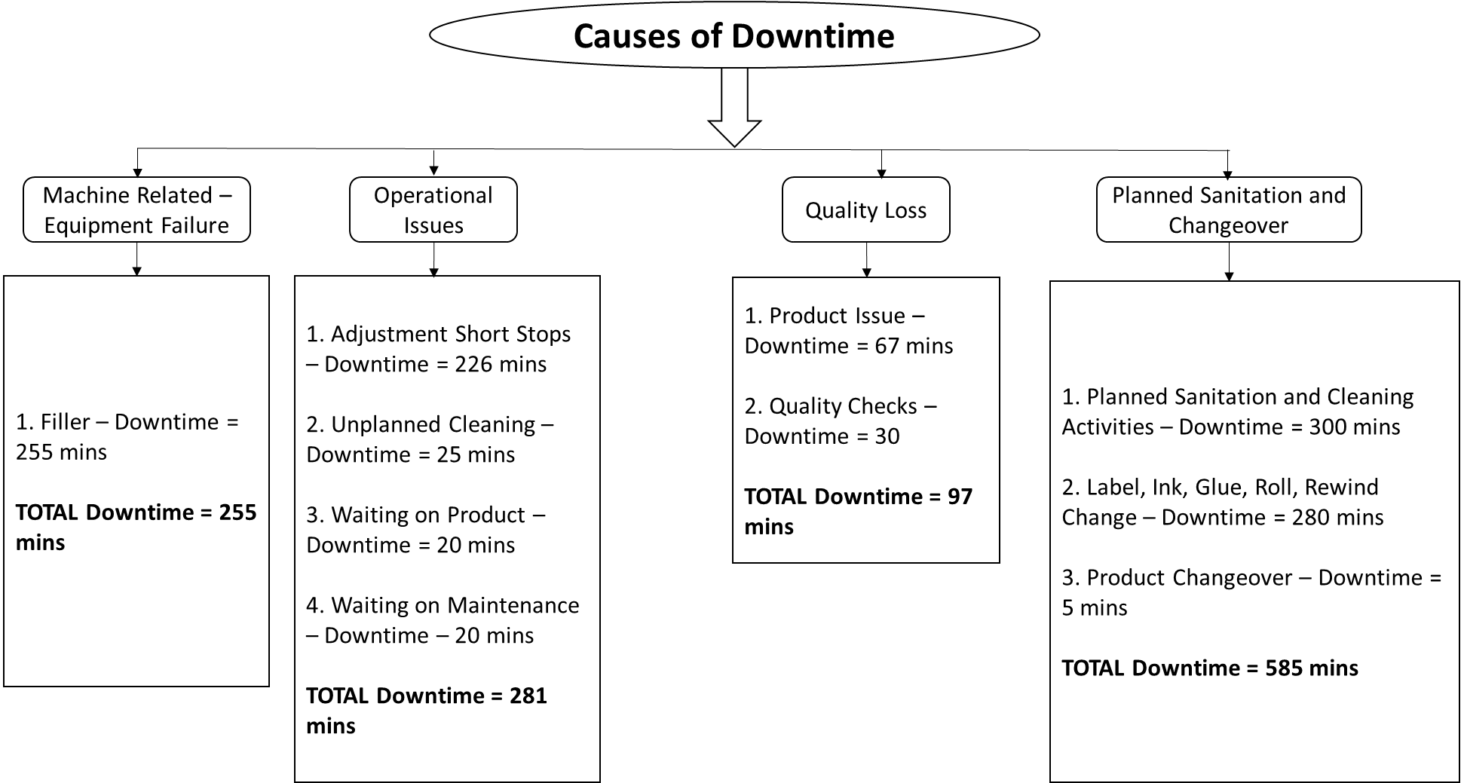
5.6 Sachet Line(1st March to 1st April 2023)
4 x Pouches of 50gms in one box

Slide 15
6. Addressing Research Question 2
What impact is current downtime having on the cost of production and planned output?

Slide 16
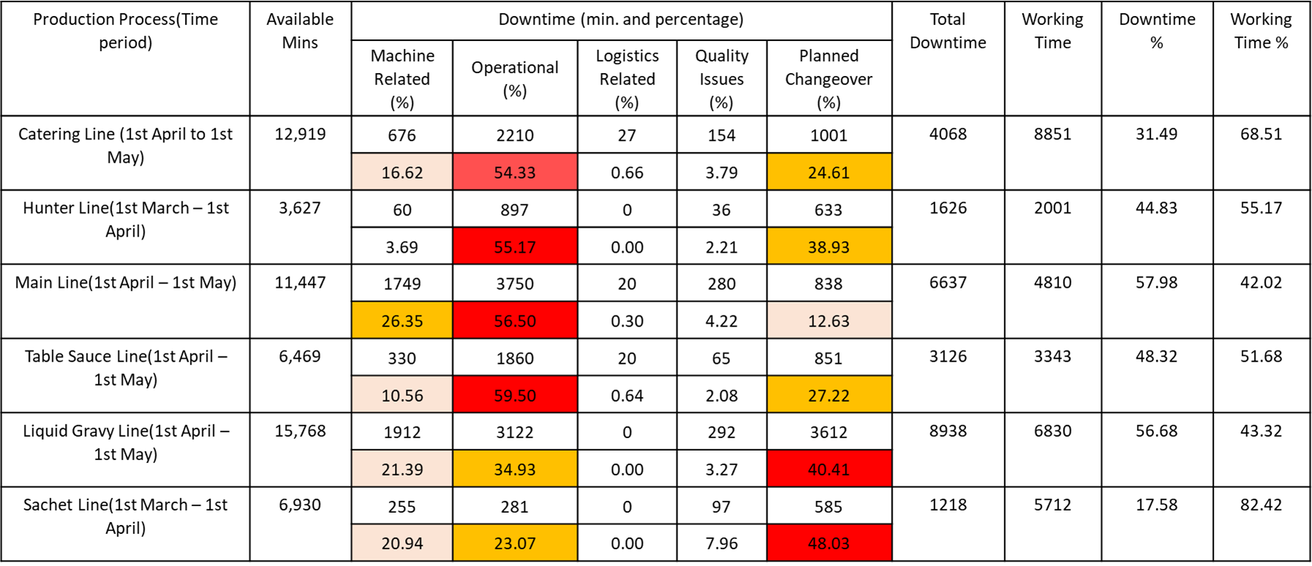

Slide 17
7. Addressing Research Question 3
What patterns or trends can be observed regarding downtime occurrences and their impact on production targets?

Slide 18
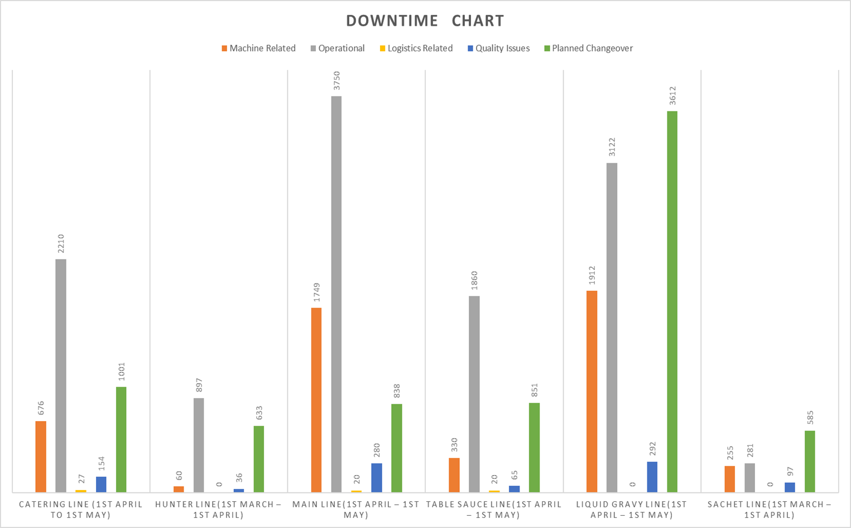

Slide 19
8. Addressing Research Question 4
What approaches can be adopted to reduce downtime?

Slide 20
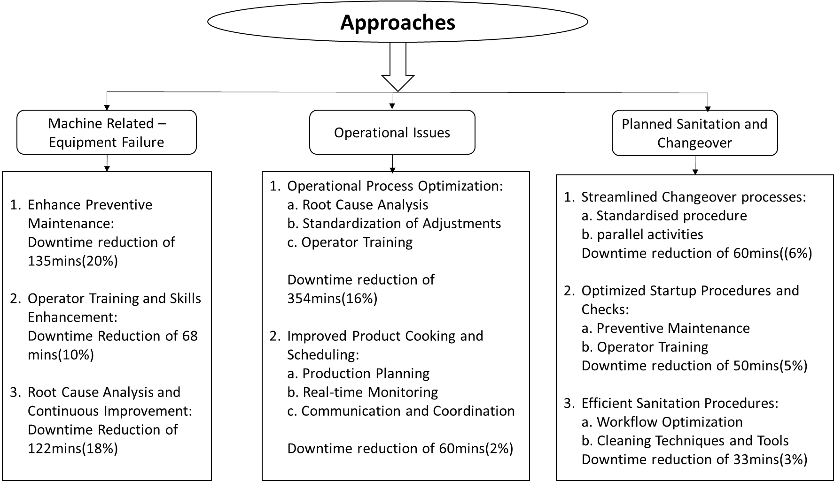
8.1 Catering Line(1st April to 1st May 2023)
Sauce Bottles ranging from 2 litres to 4 litres

Slide 21
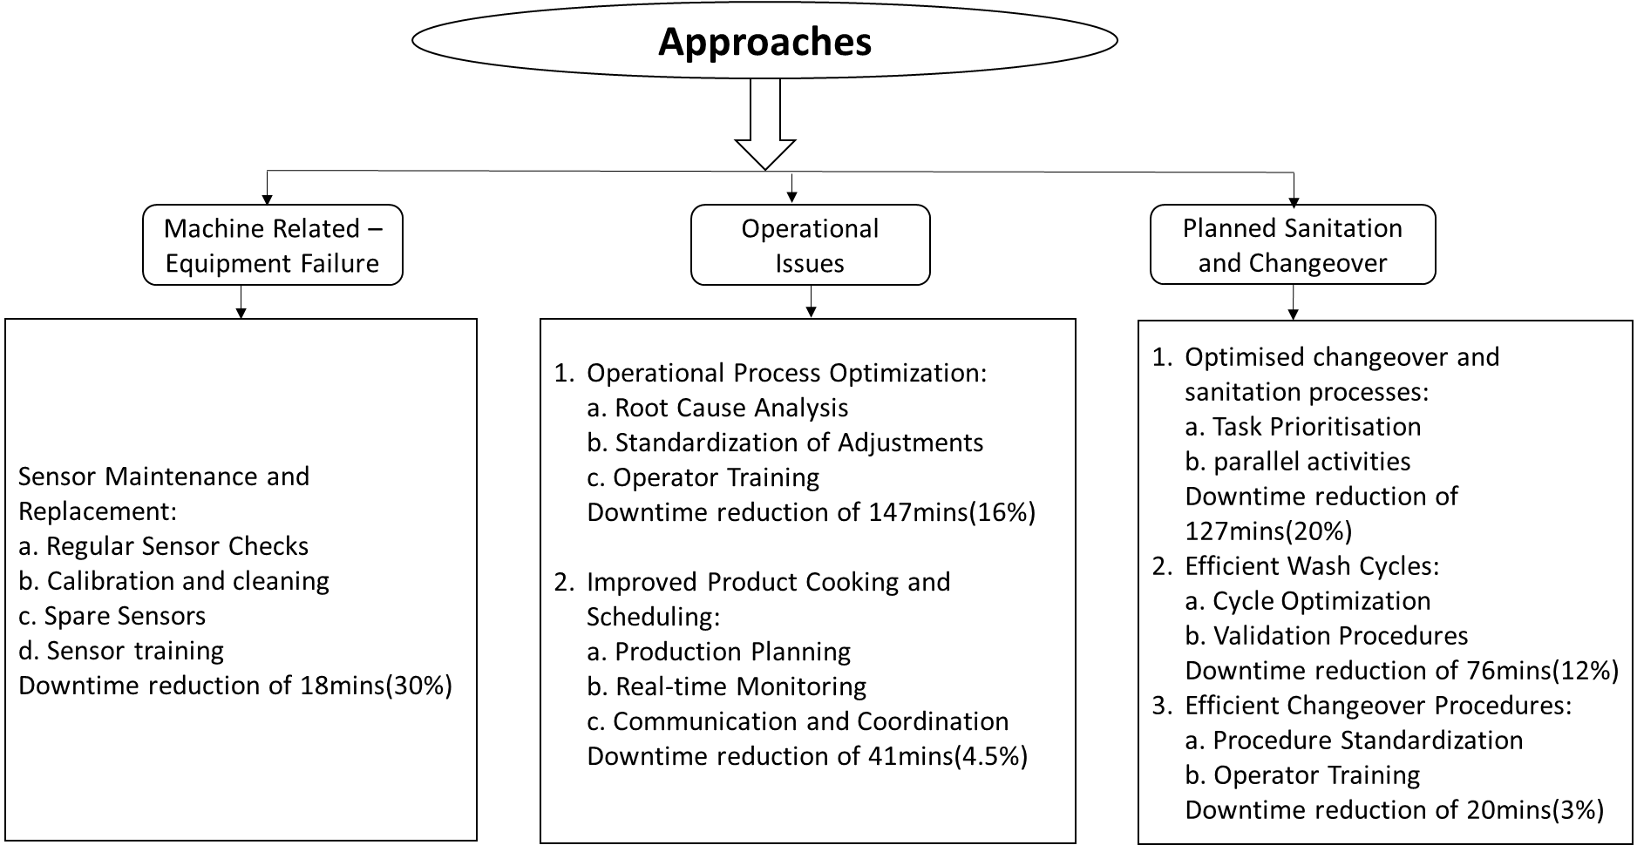
8.2 Hunter Line(1st March to 1st April 2023)
Sauce Bottles ranging from 2 litres to 4 litres

Slide 22

8.3 Main Line(1st April to 1st May 2023)
Sauce Bottles of range 500ml-600ml (plastic/glass)

Slide 23
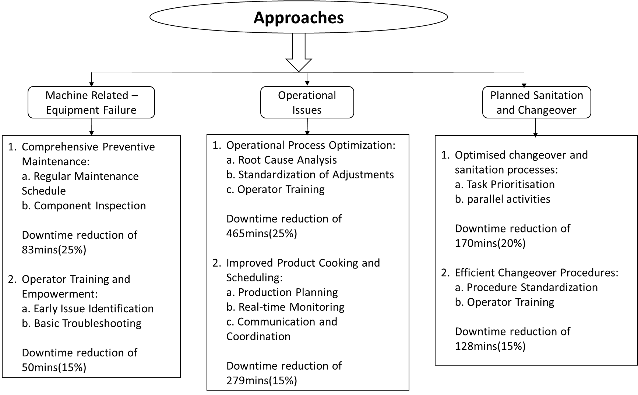
8.4 Table Sauce Line(1st April to 1st May 2023)
Sauce Bottles of range 200ml-400ml (glass)

Slide 24
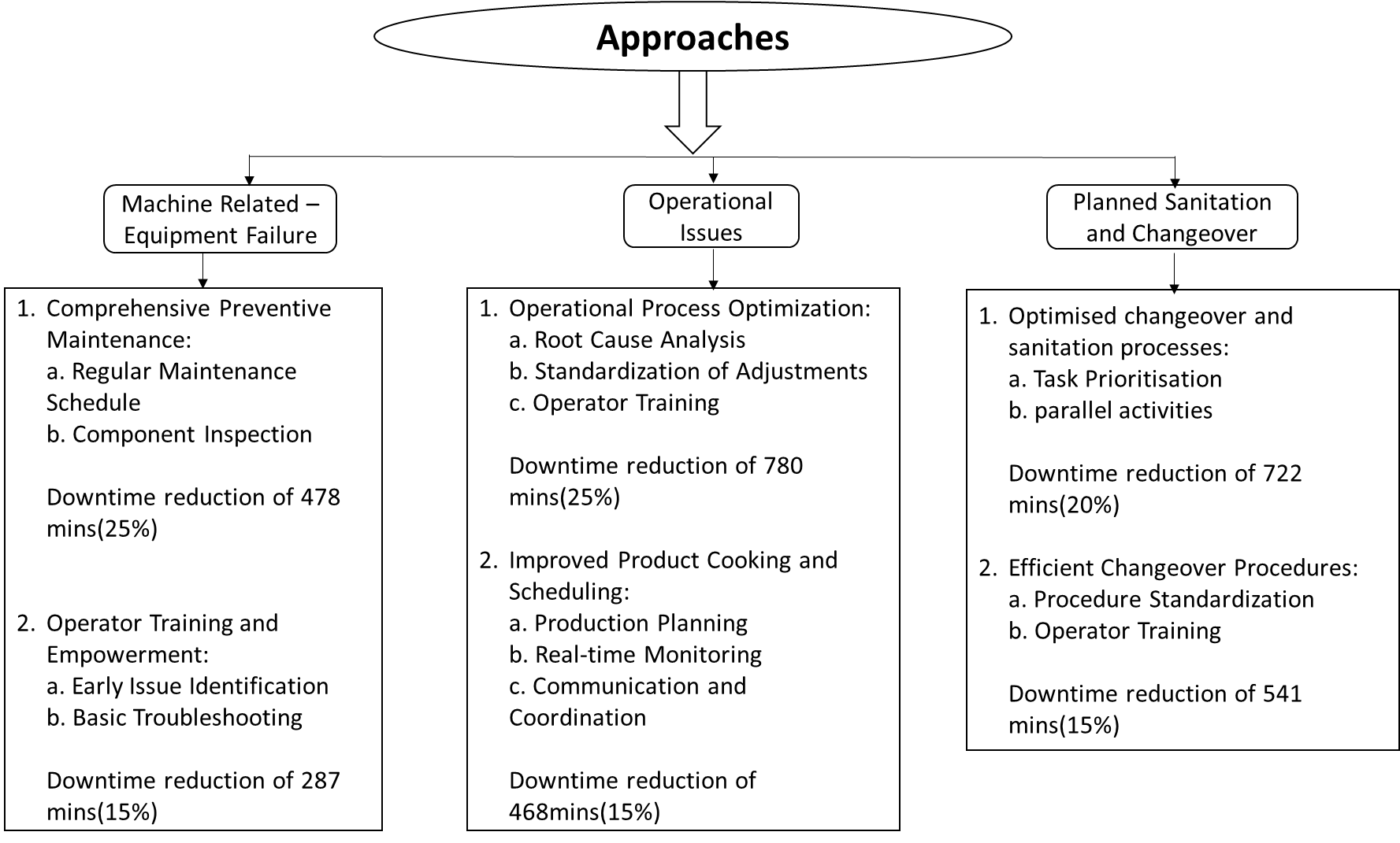
8.5 Liquid Gravy Line(1st April to 1st May 2023)
Pouches of 200gms

Slide 25
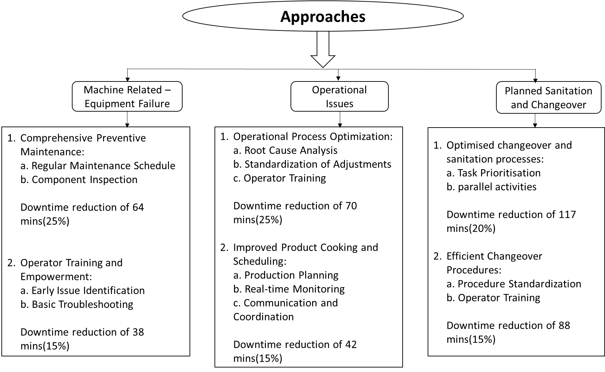
8.6 Sachet Line(1st March to 1st April 2023)
4 x Pouches of 50gms in one box

Slide 26
9. Addressing Research Question 5
Based on the findings of the above four research questions, what recommendations can be provided to ensure that proper maintenance procedures are used to reduce downtime on priority production lines so that production can be enhanced?

Slide 27
9.1 Recommendations
Implement a comprehensive preventive maintenance program with a well-structured schedule and regular component inspections, while empowering operators with training in early issue identification and basic troubleshooting techniques.
Implement operational process optimization by conducting thorough root cause analyses, standardizing adjustments, and providing operator training; enhance product cooking and scheduling through effective production planning, real-time monitoring, and improved communication and coordination.
Enhance changeover and sanitation processes by prioritizing tasks and implementing parallel activities, while also optimizing changeover procedures through procedure standardization.

Slide 28
9.1 Recommendations(contd.)
Recommendation 1: Comprehensive Preventive Maintenance.
Regular Maintenance Schedule: Establish a consistent maintenance calendar for each production line, outlining specific maintenance activities, their frequencies, and responsible personnel.
Component Inspection: Implement regular inspections of critical components on each production line, including sensors, pumps, conveyors, and machinery parts, to identify signs of wear, corrosion, or malfunction.
Early Issue Identification Training: Provide comprehensive training to operators and maintenance personnel to recognize early signs of equipment issues, enabling them to take proactive measures to prevent downtime.
Basic Troubleshooting Techniques: Equip operators and maintenance staff with fundamental troubleshooting skills to address minor issues promptly and effectively, reducing the need for external assistance.

Slide 29
9.1 Recommendations(contd.)
Recommendation 2: Operational process optimization.
Root Cause Analysis Implementation: Introduce a structured root cause analysis approach to identify underlying factors causing operational issues and downtime, leading to targeted solutions.
Standardization of Adjustment Procedures: Develop standardized procedures for adjustments made during production, ensuring consistency and reducing the risk of errors.
Operator Training Enhancement: Provide comprehensive training to operators on operating machinery, troubleshooting common issues, and adhering to standardized procedures.
Cross-Functional Collaboration: Foster collaboration between different departments involved in the production process to share insights, address challenges, and enhance overall efficiency.
Scheduling Optimization: Fine-tune production schedules based on historical data, product demand, and machine capacity to minimize idle time and maximize efficiency.

Slide 30
9.1 Recommendations(contd.)
Recommendation 3: Enhancement changeover and sanitation processes.
Task Prioritization Strategy: Develop a systematic approach for prioritizing tasks during changeovers and sanitation processes, ensuring efficient allocation of resources and time.
Parallel Activities Implementation: Introduce the concept of parallel activities during changeovers and sanitation, allowing multiple tasks to be executed simultaneously to reduce downtime.
Procedure Standardization: Standardize changeover and sanitation procedures across all production lines, creating a unified approach that minimizes errors and promotes consistency.
Operator Training and Skill Development: Provide specialized training to operators for effective execution of changeovers and sanitation tasks, empowering them to perform their roles proficiently.
Equipment Accessibility Enhancement: Design equipment layouts that facilitate easy access for cleaning and changeover tasks, reducing the time required for these activities.

Slide 31
9.2 Benefits of Downtime Reduction
The incremental revenue generated from increased production resulting from the implementation of downtime reduction measures will be substantial enough to offset the initial investment costs. Moreover, as the efficiency enhancements take full effect, the associated costs are anticipated to decrease progressively, particularly within the first year of implementation.

Slide 32
10. Challenges
Resistance to Change: Overcoming reluctance from employees to adopt new practices and procedures.
Resource Allocation: Ensuring availability of adequate resources such as time, manpower, and tools for implementation.
Training and Skill Development: Providing necessary training for employees to adapt to new techniques and methods.
Process Disruption: Managing potential disruptions to production schedules during implementation phases.
Cultural Shift: Aligning organisational culture with new approaches and fostering a culture of continuous improvement.
Monitoring and Feedback: Establishing effective systems for monitoring progress and collecting feedback for refinement.
Sustainability: Ensuring the longevity of implemented changes by embedding them into the organisational routine.

Slide 33
11. Conclusion
In conclusion, the proposed recommendations for minimizing downtime and enhancing operational efficiency at Kraft Heinz Seven Hills offer a comprehensive approach to address challenges while fostering a culture of continuous improvement. These strategies, including preventive maintenance, process optimization, and streamlined changeover practices, position the organisation for increased productivity and sustained success.

Slide 34
Thank You

